Slide 1
BDD

Slide 2
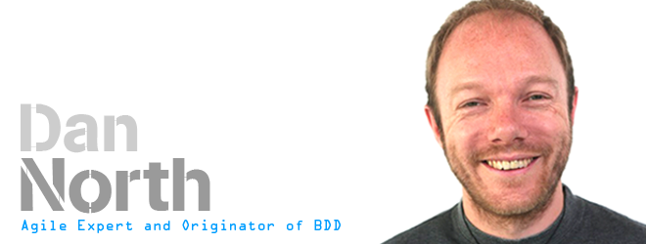
BDD is evolution of TDD
Using examples to clarify requirement
Developing and using ubiquitous language
Test method names should be sentences
testFindsCustomerById
testFailsForDucplicateCsutomers
Test Method name should start with ‘should” word
shouldFindCustomerById
shouldFailForDuplicateCustomers
TestCase class should be Nouns in test method sentences
class CustomerTableTest Extends \PHPUnitTestCase{
    /**
    * @Test
    */
    shouldFindCustomerById(){
    }
    }
    http://dannorth.net/introducing-bdd/
Programmers wanted to know
where to start
what to test and
what not to test
how much to test in one go,
what to call their tests, and
how to understand why a test fails.

Slide 3
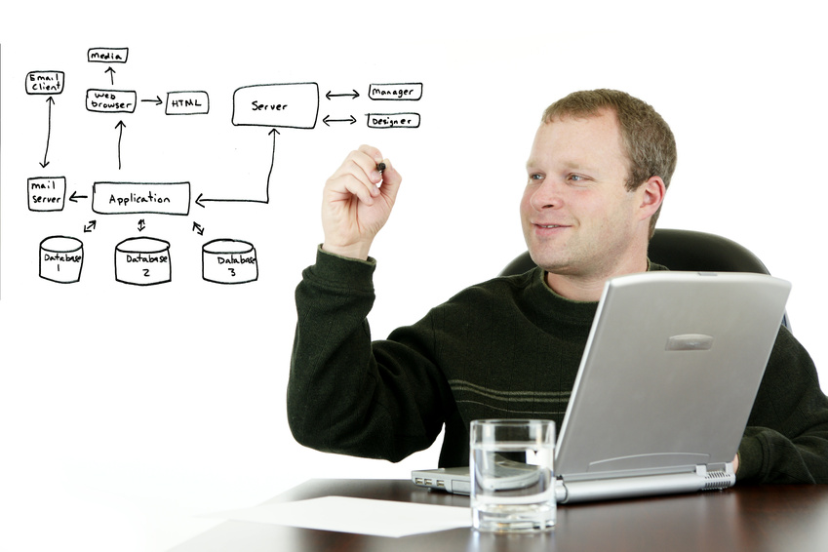
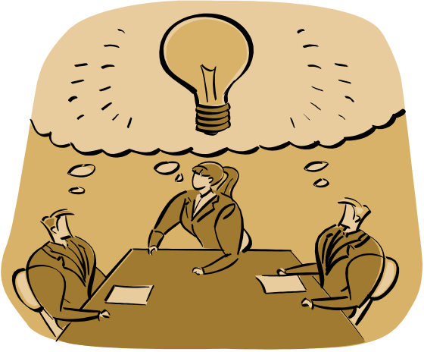
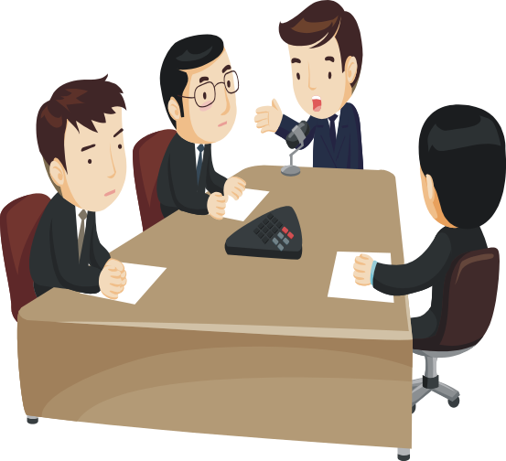
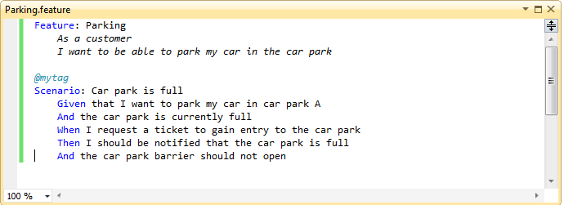

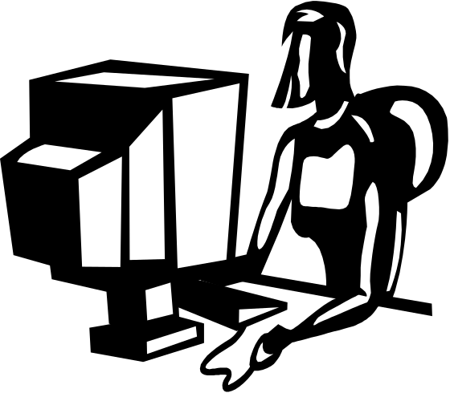

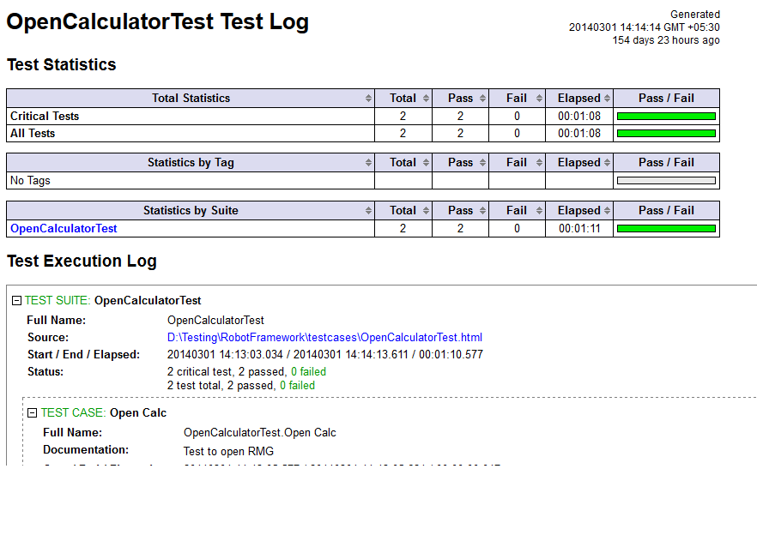
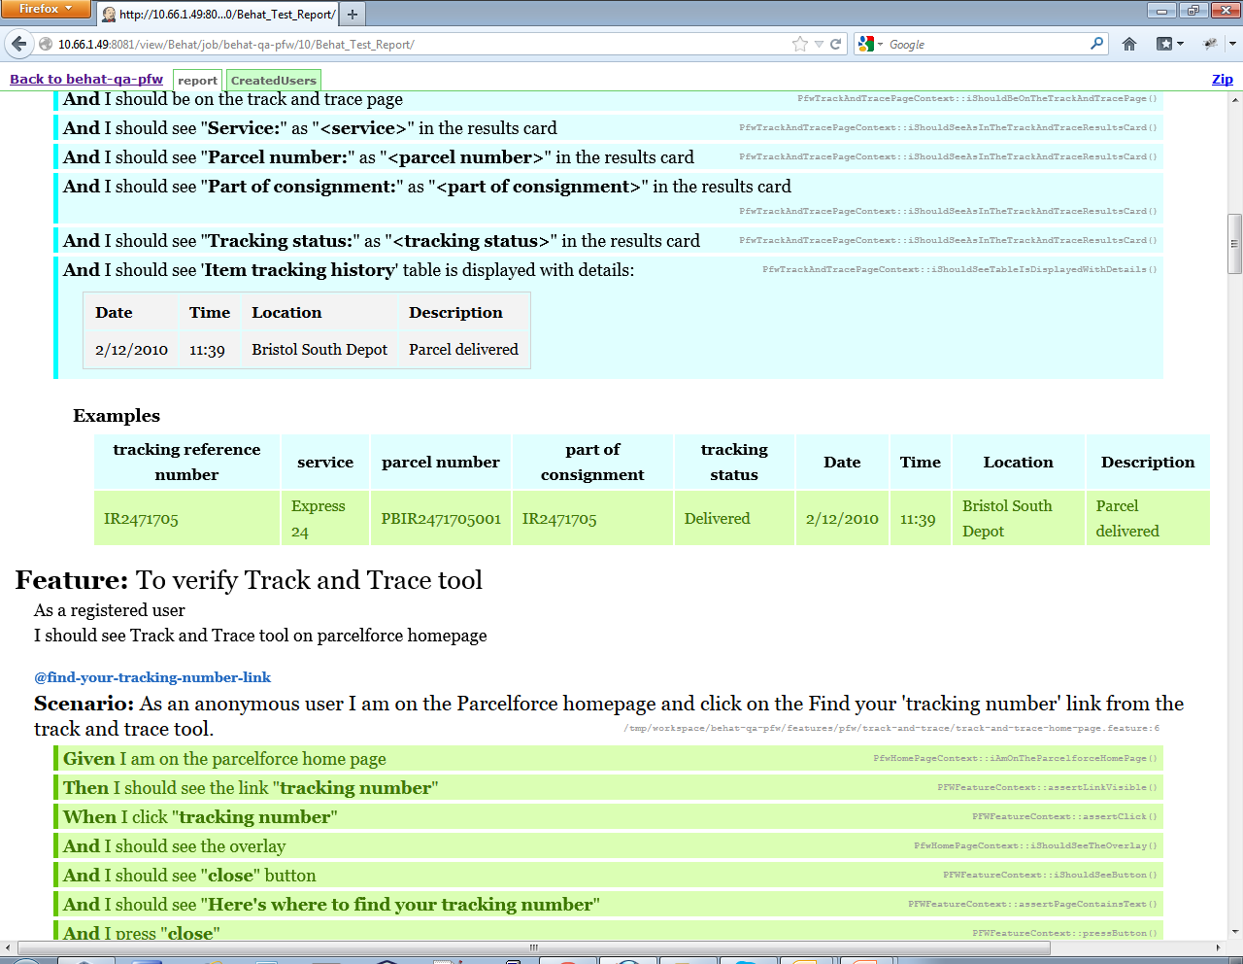
BDD development process
2.The Business Analyst, Tester, Developers elaborates requirements together.
3.The scenarios act as a guide to developer and act as automated tests
they define requirements as structued, english language format "scenarios"
Given - When - Then
1. The business Owner and Business Analyst have a discussion about what it he needs.
5.Automated test provide feedback on progress and help as documentation.
4. Tester uses these scenarios as basis of her tests.

Slide 4

Building one Vocabulary :
eliminating some of ambiguity and miscommunication
for analyst
for Business
for Testers
for Developers

Slide 5
What is all these DD’s
TDD :
Helps programmers to write better code by writing test before the production code
ATDD :
Start from failing end to end acceptance test.
OR
ATDD is to describe functional requirements of a story as concrete examples or expectations before development is started.
STDD :
Story test driven development
The basic premise is that before any code is written, a team takes a story ( rough idea of requirement ) and fleshes out that story by producing and an executable “story-test”.
Story tests are a set of automated tests written by Customer that validates that the system is functioning as specified by the stories.
BDD :
focus on behavior of the feature.
BDD’s focus is to discover the things we didn’t know ,especially in the contexts that scenarios or examples is run in.
Specification by example:
a way to specify something by giving concrete examples on how they should work.

Slide 6
Story:
In order to [ A ] Narrative
As a [ B ] Business Rules
I need [ C ] Communication
Acceptance Criteria
A the benefit or value of feature
B the person or role who will benefit it
C some feature
Strength of story is that it forces you to indentify value of delivering a story when you first define it.

Slide 7
Gherkin Syntax:
It is a Business Readable, Domain Specific Language that lets you describe software’s behavior without detailing how that behavior is implemented.
Feature: Authorization
      In order to purchase online postage
      As a frequent customer
      I need to be able to authenticate
Scenario: Successfully authenticating with correct credentials
    Given there is a user "xyz" with password "zyx"
    And I am on login page
    When I enter "Email address" with email address “newuser@example.com”
    And I enter "Password" with password
    And I press "Login"
    Then I should see My profile
The purpose of givens is to put the system in a known state before the user (or external system) starts interacting with the system (in the When steps). Avoid talking about user interaction in givens. If you had worked with use cases, you would call this preconditions.
The purpose of When steps is to describe the key action the user performs
The purpose of Then steps is to observe outcomes. The observations should be related to the business value/benefit in your feature description. The observations should also be on some kind of output – that is something that comes out of the system
Narrative
Possible scenarios
Scenario details

Slide 8
Example of user story in Gherkin :
Story Card
Feature: Customer withdraws cash User Story
I order to withdraw cash from an ATM In order to <feature>
As a customer As a <role>
So that I don’t have to wait in line at the bank I need to <benefit>
Scenario: Account is in Credit
Given the account is in credit
And the card is valid
And the dispenser contains cash
When I request cash
Then the account should be debited
And I should get cash
And card should be returned.
Scenario: Account is in debit
Given Account is in debit
And the card is valid
When I request for cash
Then error message should be displayed
And cash should not be dispensed
And card should be returned.

Slide 9
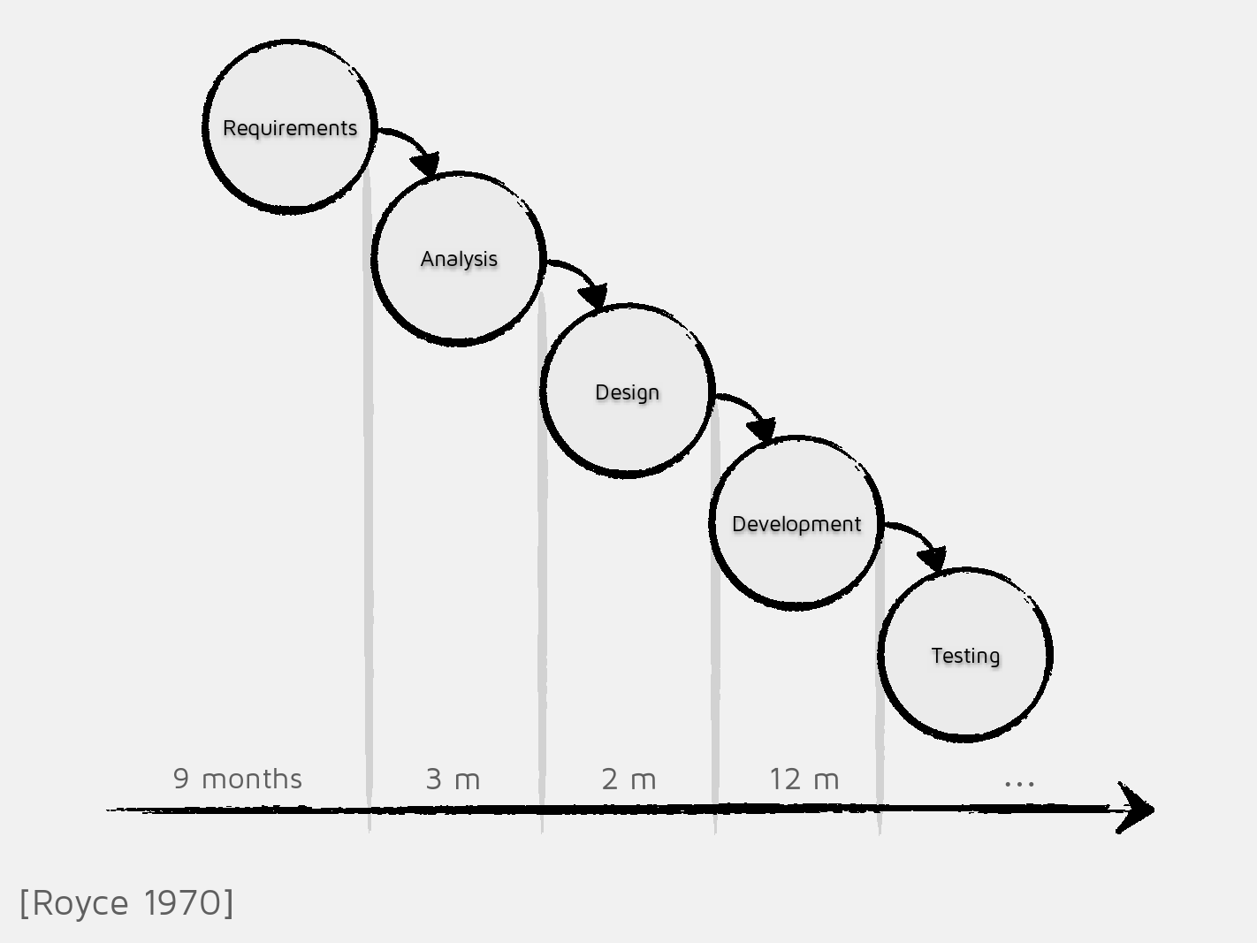
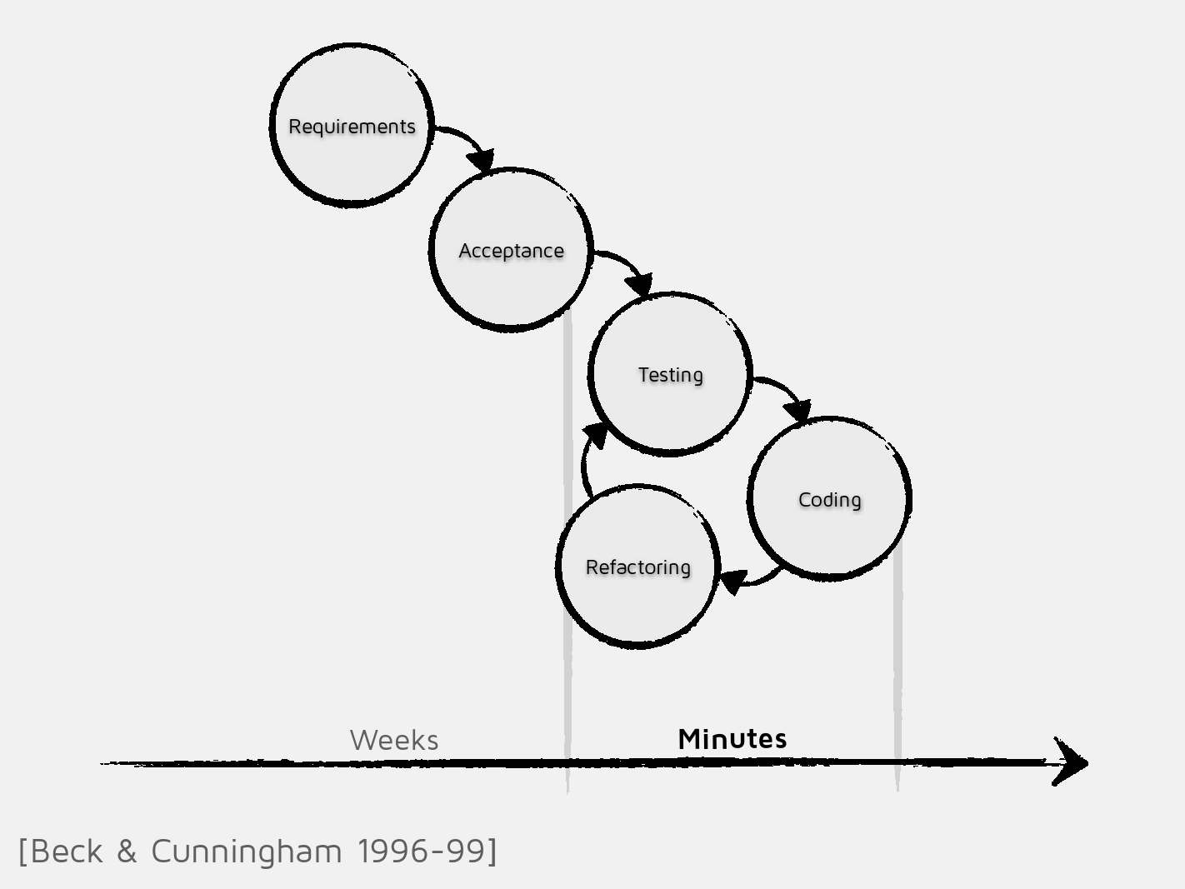
TDD reduced that delay by writing test for feature which does not exist.
Most of the cost in software development is feedback delay

Slide 10
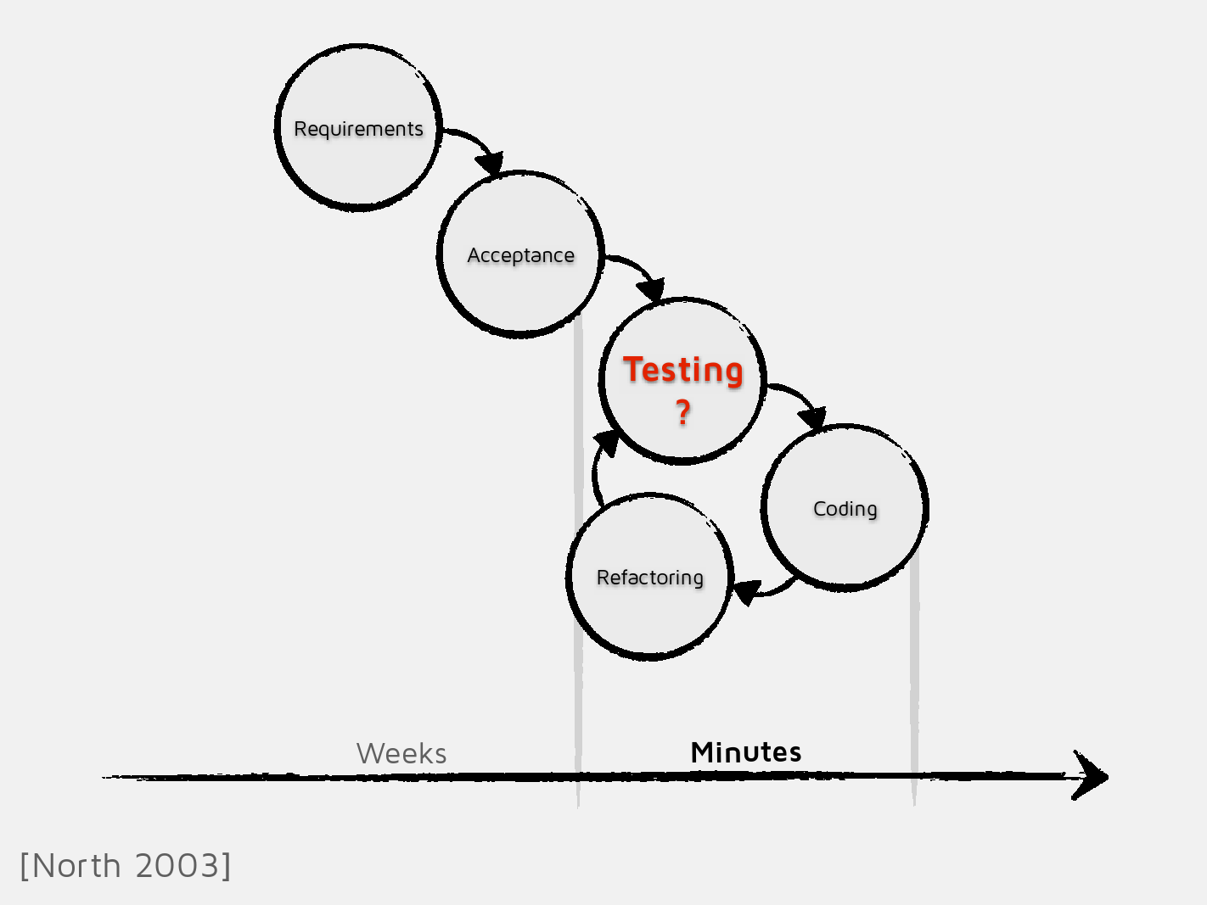
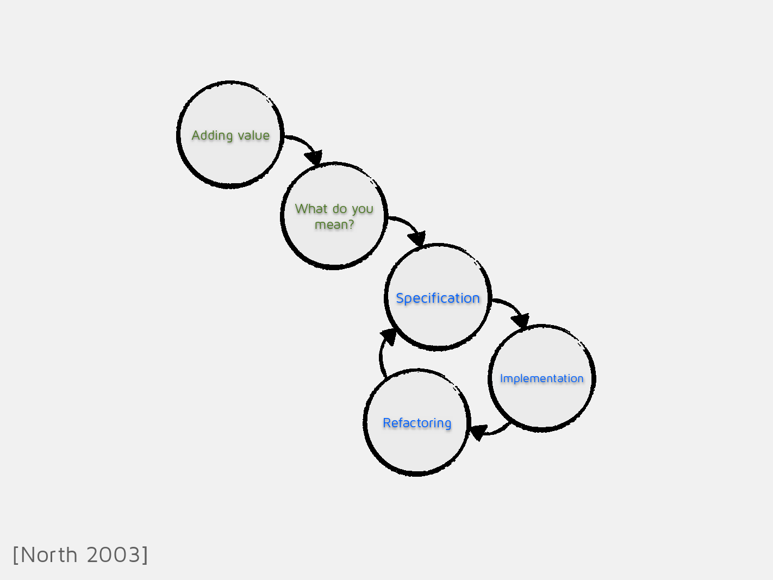

Slide 11
